Slide 1

ANXIETY-SUPPORT WEARABLE SYSTEM
Jewelry That Cares
Harnessing smart jewelry for emotional well-being
Capstone Project, Phase A
Alaa Barazi & Noor Zid Elkelani
Advisor: Dr. Naomi Unkelos Shpigel
Software Engineering Department | Project Code 26-2-D-9
1
Notes:
Good [morning/afternoon]. We're Alaa and Noor, Software Engineering students here at Shenkar, and over the next fifteen minutes we'll walk you through Phase A of our capstone project: Jewelry That Cares, a smart jewelry system that detects anxiety attacks in real time and helps patients calm down, while keeping their therapist in the loop. This project sits at the intersection of wearable technology, AI, and mental health support, and was developed under the guidance of Dr. Naomi Unkelos Shpigel. We'll start with the problem and the research behind it, then walk through what we built and where the project goes next.

Slide 2



INTRODUCTION
The problem we are solving
Anxiety prevalence
A gap in support
A technology opportunity
Most prevalent mental health challenges globally.
Therapy helps, but it’s not there in the moment..
Wearable + AI offer a huge change.
2
Notes:
Anxiety disorders are one of the most common mental health challenges worldwide, and they affect daily functioning and quality of life significantly. The core problem is a gap in support: traditional therapy is effective, but it can't be there with the patient in the moment an anxiety attack actually happens, outside the clinic. That's exactly where we saw an opportunity. Wearable technology combined with AI lets us shift from passive monitoring to something that actively senses what's happening and responds immediately, in real time.

Slide 3
PROJECT TIMELINE
Our journey: from research to system design
Phase A — completed
Phase B — planned
MARCH
MAY
OCTOBER
DECEMBER
Literature review
Requirements
React Native build
ML-based detection
APRIL - MAY
MAY - JUNE
NOVEMBER
JANUARY
Expert interviews
System design
Jewelry integration
User testing
3
Notes:
Before we dive into the details, here's the path this project has taken, laid out month by month. Phase A ran from March through June: we started with our literature review in March, ran structured interviews with eight mental health professionals across four sectors in April, derived our functional and non-functional requirements in May, and finished the full system design you'll see today in June. Phase B then runs October through January: we'll build out the full React Native application in October, integrate real Bluetooth communication with our jewelry prototype in November, replace our simulated detection with an actual trained ML model in December, and finally test the system with real patients and therapists in January

Slide 4



BACKGROUND
Literature review
AI and wearables for anxiety detection
Castillo Zorro et al. (2026) reviewed 77 studies on physiological and behavioral detection. Alkurdi et al. (2025) showed ML models on ECG and EDA signals achieve reliable real-world performance. Bhimani et al. (2025) demonstrated continuous AI-driven monitoring is highly feasible outside clinical settings.
Haptic feedback for intervention
Fason et al. (2025) found vibration-based haptic patches significantly reduce anxiety with high user satisfaction. Mishra et al. (2025) built a closed-loop emotionally intelligent system that auto-detects anxiety via EEG and delivers immediate calming feedback.
Integrating wearables and apps in therapy
Wang et al. (2026) showed that objective wearable data, combined with subjective mood reports through a mobile app, successfully supports group CBT therapy, validating the holistic approach this project takes.
4
Notes:
Our literature review covers three threads of research. First, AI and wearables for detection: recent work shows that machine learning models on heart rate and skin conductance signals can reliably detect anxiety even in noisy, real-world conditions, not just in a lab. Second, haptic feedback: studies show that vibration-based intervention significantly reduces anxiety and is well received by users, which is part of why we considered jewelry as the delivery mechanism. Third, integration into therapy: research shows that combining objective wearable data with subjective app-based mood reports successfully supports structured therapy like group CBT. Together, these three threads are exactly what shaped our system design.

Slide 5

RESEARCH METHODOLOGY
Recruitment challenges
Reaching the right professionals
Clinicians and social workers willing to speak candidly about anxiety treatment were hard to find.
A narrow research window
Phase A left only a few weeks to schedule and conduct interviews.
5
Notes:
Before we get into what we found, it's worth being upfront about how we got there — because it wasn't easy.
First, reaching the right professionals. Clinicians and social workers were genuinely hard to find. Most of the people we interviewed came through personal networks and academic referrals — cold outreach basically didn't work.
Second, we were working with a narrow research window, and because participants were so hard to reach, we supplemented with two AI-generated expert personas, which we'll explain in a moment.
These constraints shaped our methodology, and they're important context for how we interpret the findings that follow.

Slide 6



COMPETITIVE LANDSCAPE
Existing solutions and the gap they leave
Rootd
feeltherapeutics
Sanvello
Panic button for anxiety attacks.
Bracelet measuring temperature and heartbeat.
Community-based app with therapist chat and 1:1 coaching.
Feature comparison
Feature | Rootd | feeltherapeutics | Sanvello | The gap
Therapist (professional) side | ✗ | ✗ | ✓ | ✓
Automatic anxiety detection | ✗ | ✓ | ✗ | ✓
Documentation experience | ✗ | ✓ | ✓ | ✓
Chat with AI | ✗ | ✗ | ✗ | ✓
Connected smart wearable | ✗ | ✓ | ✗ | ✓
Community support | ✗ | ✗ | ✓ | ✓
Calming music / sounds | ✗ | ✗ | ✗ | ✓
6
Notes:
We looked closely at three existing apps. Rootd gives patients a panic button with breathing exercises, but has no therapist involvement at all. Feeltherapeutics pairs a bracelet with the app and does detect anxiety physiologically, but again, no professional side. Sanvello has strong community and therapist features, but it doesn't do any automatic detection, and it's limited to the US. As you can see in this comparison table, every existing solution is missing something. Our app is the only one that combines automatic detection, a professional therapist side, AI chat support, and community support, all in one place.

Slide 7
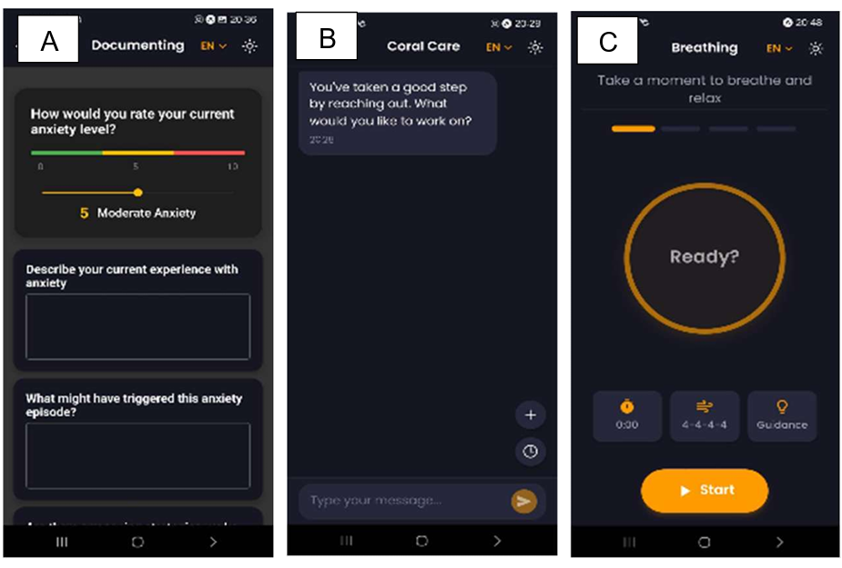
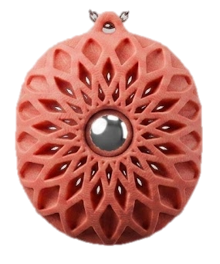

PROJECT CONTEXT
Building on what came before
BEFORE: COZY SPACE
OUR ADDITION
Phase A keeps the validated patient experience and extends it in two directions:
Smart jewelry hardware
A physical wearable with click & roll input and Bluetooth streaming, replacing the phone-only interface.
Community & moderation
Anonymous peer support, and a moderated community layer with a dedicated admin web app.
7
Notes:
Before going further, it's worth placing this project in context. A previous student team built Cozy Space, a mental wellness app with mood documenting, an AI chat companion, and guided breathing exercises, and they validated it through user experiments with 20 participants. That work proved the core concept: people are willing to engage with a digital companion for anxiety support. Our project takes that validated foundation and extends it in two directions their work didn't cover. First, we move beyond the phone-only interface to a physical smart jewelry device, so support is available the moment symptoms begin, not just when someone opens an app. Second, we add a moderated community layer with peer support and gamification, turning an individual tool into a shared support system.

Slide 8


RESEARCH METHODOLOGY
Grounding the system in clinical practice
Human professionals interviewed
AI-generated expert personas
Sectors represented
8
2
4
Code | Role | Sector | Experience
P1-P4 | Clinical psychologists / psychotherapists | Private practice, hospitals, trauma centers, NGOs | 7-20+ years
SW1-SW2 | Hospital social workers | Public hospitals (Western population) | 5-30 years
W1-W2 | Welfare social workers | Municipal welfare (non-Western population) | ~2.5-4 years
AI1 | Clinical psychologist persona (Gemini) | Private clinic | 10 years
AI2 | Social worker persona (Claude) | Municipal welfare | 9 years
Unkelos-Shpigel N. & Levy, M. (2026). Biases in Human and AI-Assisted Requirements Elicitation for Mental Health Wearables: An Empirical Analysis. In 2026 IEEE 34rd International Requirements Engineering Conference Workshops (REW) . IEEE.
8
Notes:
To make sure our system reflects real clinical practice and not just our own assumptions, we interviewed eight mental health professionals: clinical psychologists, hospital social workers, and welfare-sector social workers, covering both Western and non-Western patient populations. We also included two AI-generated expert personas, one built on Gemini and one on Claude, specifically to test whether bias patterns we saw in one model would replicate in another, and to extend our coverage given the limited size of our human sample. This table summarizes who we spoke to, their sector, and their experience level.

Slide 9



RESEARCH FINDINGS
Interview insights
Symptoms & coping
Personalization & therapist role
Safety & community boundaries
Physical, emotional & cognitive symptoms: rapid heartbeat, panic, overthinking
Coping tools: breathing, grounding, CBT techniques, talking to trusted people
Patients choose tools in advance; therapists tailor techniques to each patient
Remote monitoring and progress updates are valued, based on risk level
Red flag alerts notify the therapist silently, never the patient directly
Community support needs moderation and anonymity; it must supplement, never replace, real therapy
9
Notes:
Across all interviews, three things came up consistently. First, anxiety symptoms cluster into physical signs like rapid heartbeat and shortness of breath, emotional signs like panic and loss of control, and cognitive signs like overthinking. Second, the most effective coping methods are breathing techniques, five-senses grounding, and CBT-style cognitive reframing, plus simply talking to someone trusted. Third, and this came up again and again: personalization is not optional. Patients need to choose their own coping tools in advance, therapists need to tailor techniques per patient, and things like language and music preference genuinely matter for whether a patient will actually use the calming action.

Slide 10
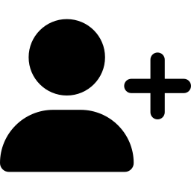




SYSTEM DESIGN
Functional requirements
Registration & login
Initial patient setup
Anxiety detection
Role-based login for patients and therapists
Choose therapist, notification style, calming actions
Detects attacks from jewelry sensor data
Calming actions
Documentation
Community
Music, breathing, grounding, AI chatbot
Notes, voice recordings, severity graphs
Anonymous posts, peer support
10
Notes:
From those clinical insights, we derived our functional requirements. Patients and therapists register with role-based access. During setup, patients choose their therapist, notification preferences, and preferred calming actions in advance, directly reflecting the personalization finding from our interviews. The system detects anxiety attacks, then offers calming actions like music, breathing, grounding, or an AI chatbot, with the choice of trigger left to the patient: an automatic alert from the jewelry, or a manual click and roll when they recognize the early signs themselves. Patients document episodes, and there's a gamification and community layer for peer support.

Slide 11


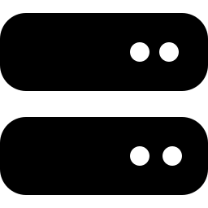
SYSTEM DESIGN
Non-functional requirements
Category | Requirement | Metric
Security / privacy | User anonymity in community | 100% of posts shown without personal data
Safety | Content moderation | 95%+ of reported content reviewed within 24h
Performance | System responsiveness | Requests answered within 3 seconds
Availability | System uptime | 99%+ annual uptime
Privacy by design
Active moderation
Fast & responsive
Built to scale
11
Notes:
On the non-functional side, given that this handles sensitive mental health data, privacy and safety are front and center: full anonymity in the community, fast moderation of reported content within 24 hours, and strong performance and uptime guarantees so the system is there when a patient actually needs it.

Slide 12




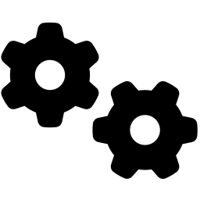



IMPLEMENTATION
System architecture
CLIENT SIDE
SERVER SIDE
Next.js + Express
Firebase Admin SDK
Smart jewelry
Firestore
Authentication
Profiles, posts, anxiety logs
Patient & therapist roles
on write
REST API
Click & roll input
Bluetooth
Cloud Functions
Cloud Messaging
REST API
Triggered server logic
Push notifications
React Native
Patient & therapist mobile app
Cloud Storage
React — admin web app for managers
Voice recordings & shared media
12
Notes:
Here's how the full system fits together. On the client side, the smart jewelry's main input is click and roll, a small roller similar to a mouse scroll wheel that lets the patient log how they're feeling or trigger a calming action without looking at their phone, and it streams that data to our React Native mobile app over Bluetooth. That one app serves both patients and therapists. We've also added a separate React admin web app on the client side specifically for our community managers. On the server side, Firestore is our real-time database for profiles, posts, and anxiety logs, Authentication handles role-based access, and when something gets written to Firestore, like a new anxiety episode, that automatically triggers a Cloud Function, which calls Cloud Messaging to alert the therapist. Cloud Storage holds voice recordings and shared media, and we've layered in Next.js with Express for the small number of custom REST endpoints that sit outside Firebase's serverless functions.

Slide 13



SYSTEM DESIGN
Who uses the system, and how
Patient
Smart jewelry
Therapist
Community manager
Views anxiety alerts and uses calming actions
Documents episodes; can share with therapist
Joins the community: posts, reports content
Detects anxiety indicators from sensor data
Transmits signals to app.
Views patient reports and attack-frequency trends
Provides emergency support on active alerts
Customizes calming plans per patient
Moderates community content
Deletes posts
13
Notes:
Four roles use this system. Patients view alerts, use calming actions, and document episodes. The smart jewelry just detects and transmits sensor data — no decisions on its own. Therapists track patient trends and step in during active alerts. Community managers moderate content, removing posts only when a patient's report flags something.

Slide 14
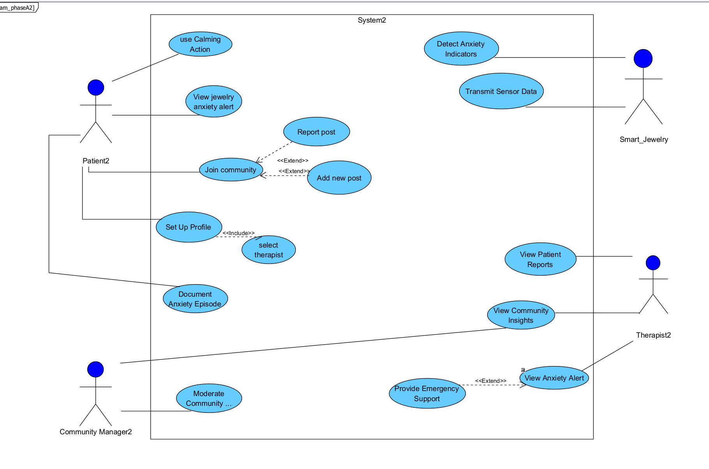
SYSTEM DESIGN
Use case diagram
14
Notes:
This is our use case diagram. It captures everything we just walked through, the Patient, Smart Jewelry, Therapist, and Community Manager actors, along with how their use cases relate through include and extend relationships. For example, Set Up Profile includes selecting a therapist and setting notification preferences. Use Calming Action generalizes into the four concrete calming actions: music, breathing, grounding, and voice notes. And Report Post, which only the patient can do, extends into the Community Manager's content moderation flow, since a patient's report is what triggers a review. The full Use Case diagram is in our book.

Slide 15
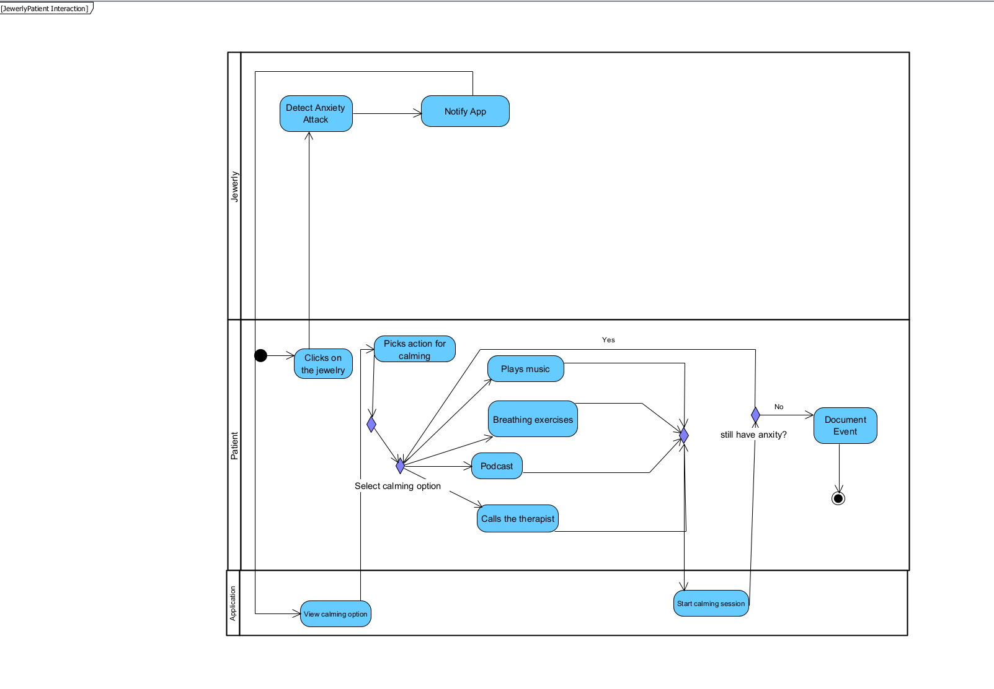
SYSTEM DESIGN
Activity diagram: jewelry and patient interaction
15
Notes:
This activity diagram shows the full flow of an anxiety episode from the jewelry's perspective. The jewelry detects an anxiety attack and notifies the app, which presents the patient with calming options. The patient picks one action, music, breathing, a podcast, or calling the therapist, and the app starts a calming session. The system then checks whether the anxiety has subsided: if not, the patient loops back to try another action; once resolved, the episode is documented and the flow ends.

Slide 16
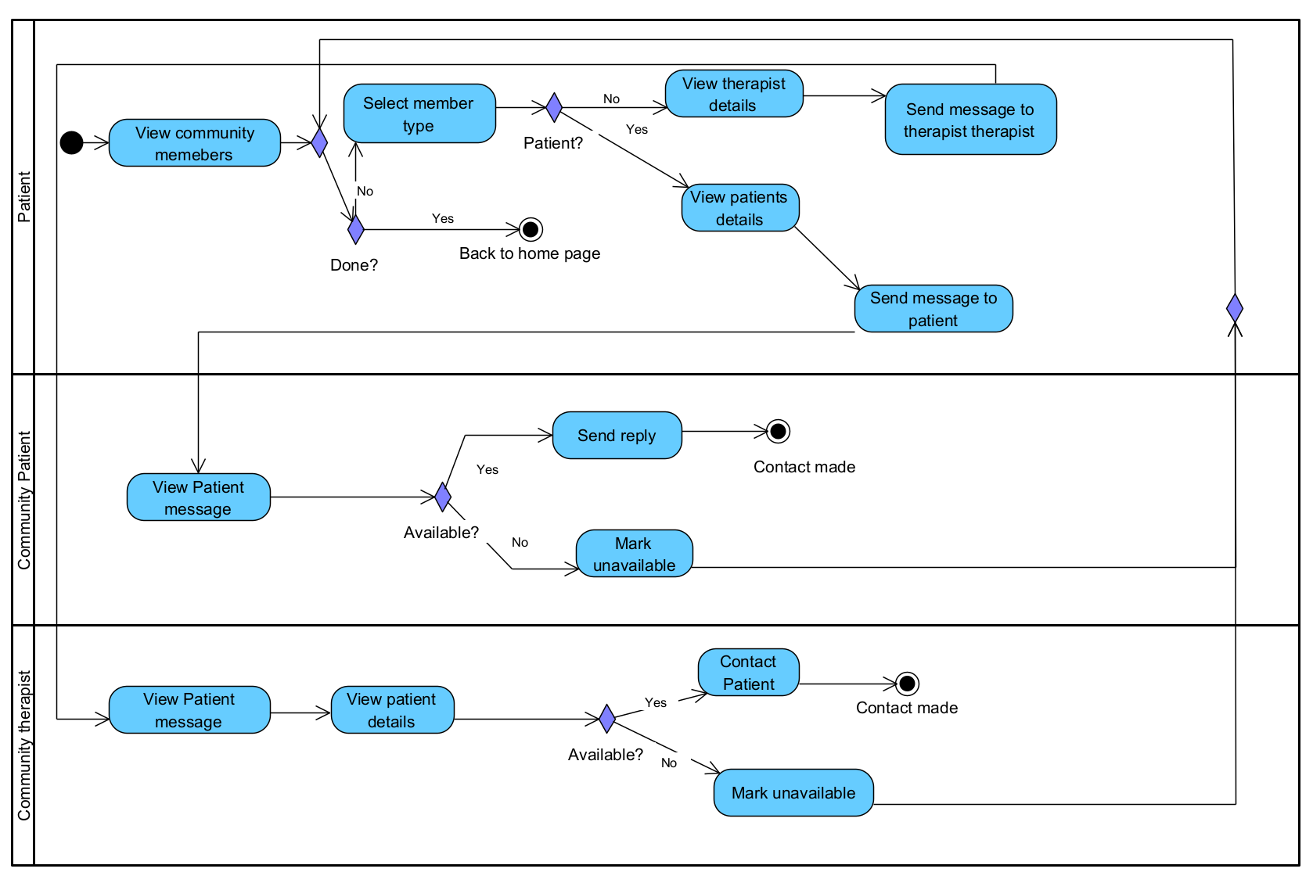
SYSTEM DESIGN
Activity diagram: community flow
16
Notes:
This second activity diagram covers the community messaging flow across three lanes: the Patient, the Community Patient receiving a message, and the Community Therapist receiving a message. The patient browses community members, selects a patient or therapist, and sends a message. If the recipient is unavailable, the flow loops back so the patient can pick someone else or exit through the Done decision, rather than getting stuck waiting.

Slide 17
LOOKING AHEAD
How we'll measure success
70%+
95%+
99%+
Patient & therapist adoption, with 85%+ satisfaction on the System Usability Scale
Of harmful or reported community content reviewed within 24 hours
Annual system uptime, supporting 10,000+ concurrent users
Phase A established the full clinical, technological, and architectural foundation. Phase B will bring the system to life. Thank you.
17
Notes:
To wrap up: how will we know this is working? We're targeting 70% adoption among patients and therapists, with 85% or higher satisfaction measured through the System Usability Scale. On the safety side, 95% or more of harmful or reported community content needs to be reviewed within 24 hours. And on the technical side, we're targeting 99% uptime and support for 10,000 or more concurrent users without performance degradation. Phase A gave us the clinical grounding, the requirements, and the full system design. Phase B is where we bring it to life. Thank you, and we're happy to take questions.

